Slide 1
Linux Fundamental

Slide 2
What will you learn today ?
What is Operating System ?
Different Types of Operating Systems
What is Linux
Advantages of Linux.
Linux Favours

Slide 3
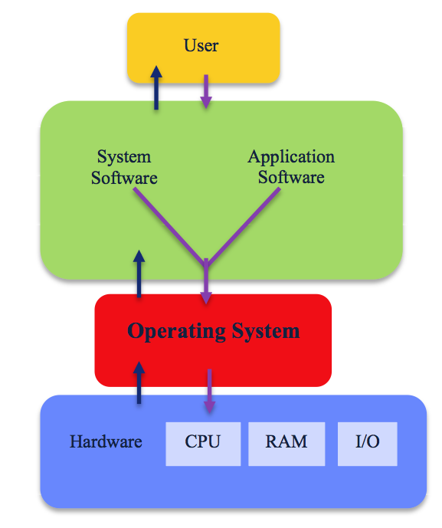
What is operating system ?
An operating System is a software/program that acts as an interface between computer hardware and the user and controls the execution of all kinds of programs.
Computer must have an at least one operating system to run other programs.
The Operating System helps to communicate with systems.

Slide 4
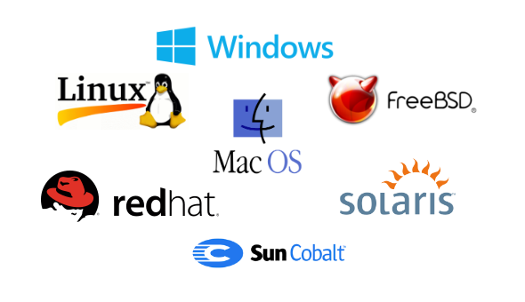
MOSTLY USED OPERATING SYSTEMS

Slide 5
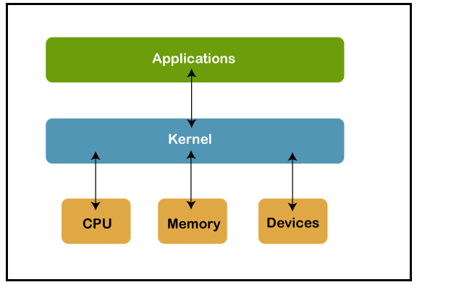
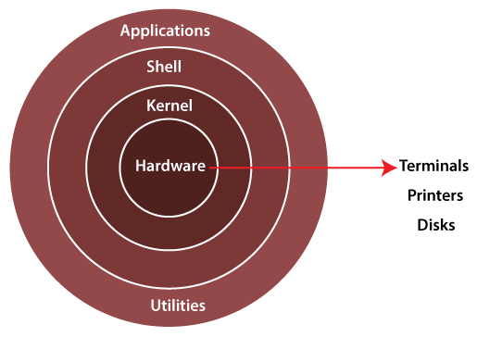
What is Linux ?
Linux is one of popular version of UNIX operating System. It is open source as its source code is freely available. It is free to use. The kernel is a core part of the Linux system.
Kernel − Kernel is the core part of Linux. It is responsible for all major activities of this operating system. It consists of various modules and it interacts directly with the underlying hardware. Kernel provides the required abstraction to hide low level hardware details to system or application programs.

Slide 6
What is a Shell
The shell is the Linux command line interpreter. It provides an interface between the user and the kernel and executes programs called commands.

Slide 7
Advantages of Linux?
Open Source
Security
Free to Use
Performance
Privacy
Networking
Compatibility
Installation
Multitasking

Slide 8


Linux flavours?
LINUX TREE
WINDOWS SERVER CORE 2008

Slide 9
Linux INSTALATION
1.Cloud Installation and Configuration
2.Internal Installation and Confutation

Slide 10
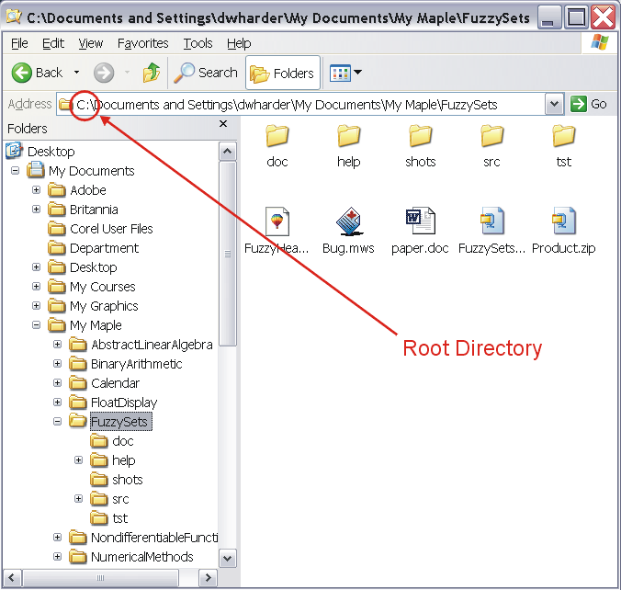
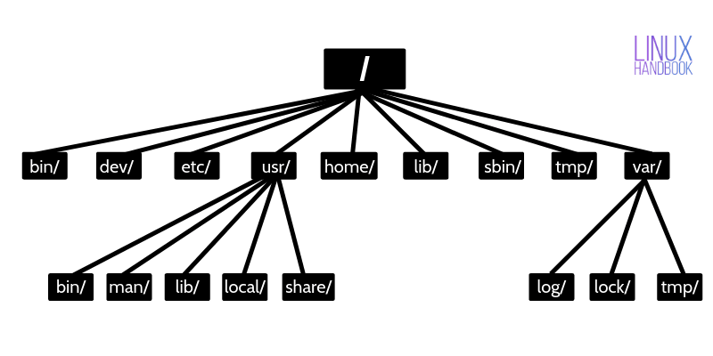
Linux vs windows directory structure
Linux file structure starts from the root directory, and it is considered as a start point of the file system. It is represented by a forward slash (/). In Linux, everything (Directories, devices, and files) is considered a file. Home directory Indicated by (~).

Slide 11
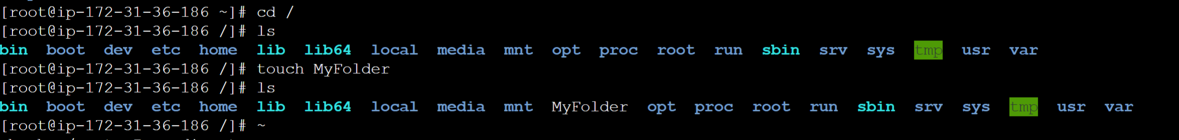
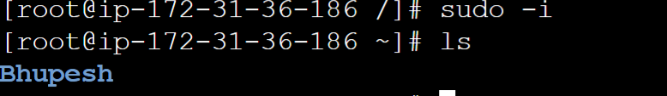
ROOT DIRECTORY VS HOME DIRECTORY
Root Directory | Home Directory
The root directory is the topmost level of the system drive. | The home directory is a subdirectory of the root directory.
It is denoted by a slash '/'. | It is denoted by '~' and has path "/users/username".
The admin has access to make any changes in the files and settings. | No user other than the root user can change the settings of the entire system.
The admin can create a user. | Any user having a home directory cannot create a user.
In the Linux file system, everything comes under the root directory.
PWD:PRESENT WORKING DIRECTORY

